Slide 1
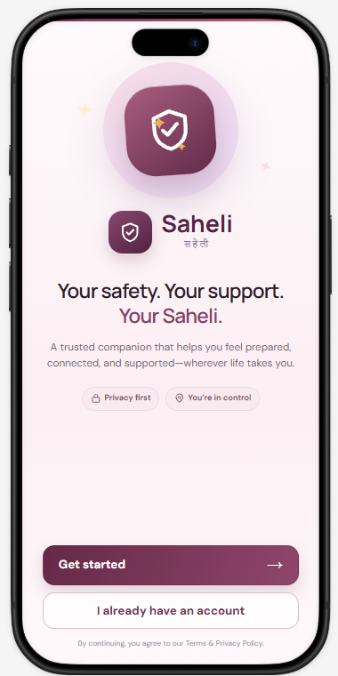
Saheli
REHERSION · NITK SURATHKAL
Your safety. Your support.
Your companion in times of need
Team Malkins

Slide 2
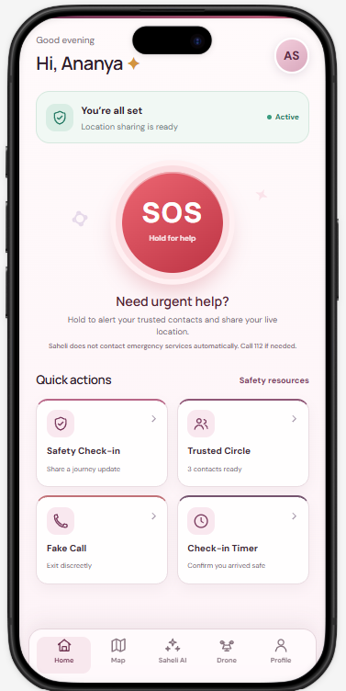
Hold once, and your people know
THE HOME SCREEN
SOS
Hold the button to alert trusted contacts and share your live location.
Quick actions
Safety check-in, trusted circle, fake call and check-in timer, one tap away.

Slide 3
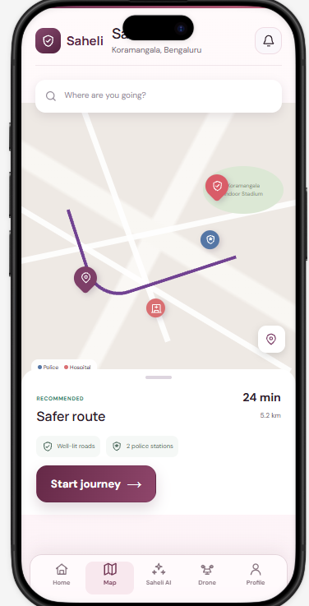
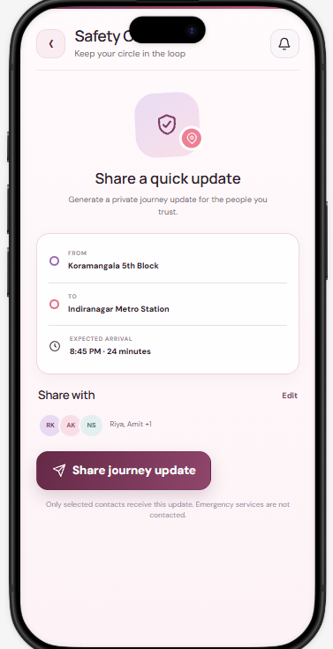
Getting there, safer
BEFORE YOU LEAVE
Safer route
Suggests a path along well-lit roads and near police stations, with time and distance.
Journey update
Share where you are going and when you expect to arrive, with only the contacts you pick.

Slide 4
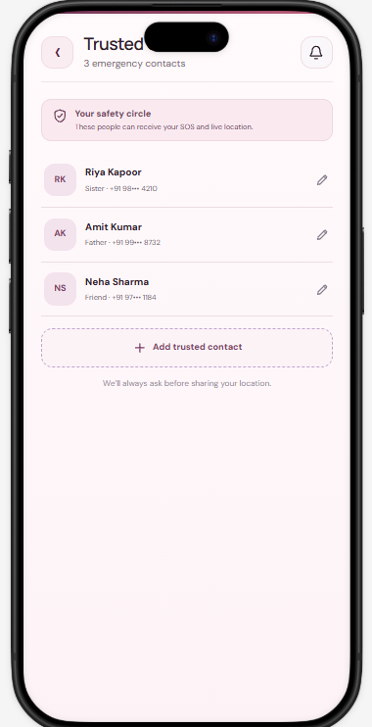
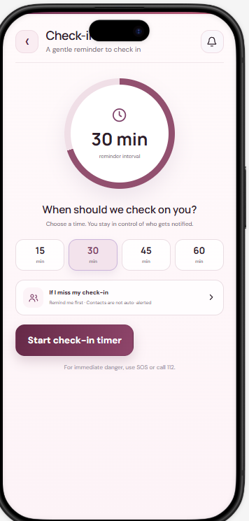
Your circle, your call
Trusted circle
Check-in timer
Family and friends who receive your SOS and live location.
A gentle reminder to confirm you arrived. You decide who is notified.

Slide 5
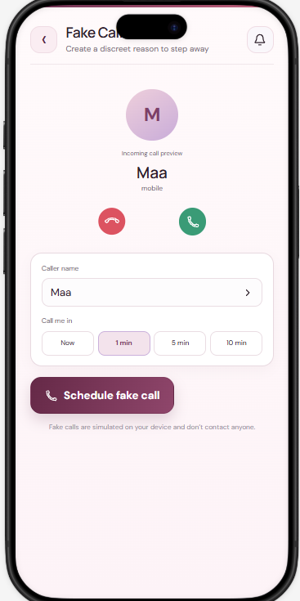
A way out, no explanation needed
STEP AWAY QUIETLY
You pick the caller
Set any name, like Maa, so the call looks completely ordinary.
You pick the moment
Ring now, or schedule it for 1, 5 or 10 minutes later.
Stays on your phone
The call is simulated on your device and contacts no one.

Slide 6
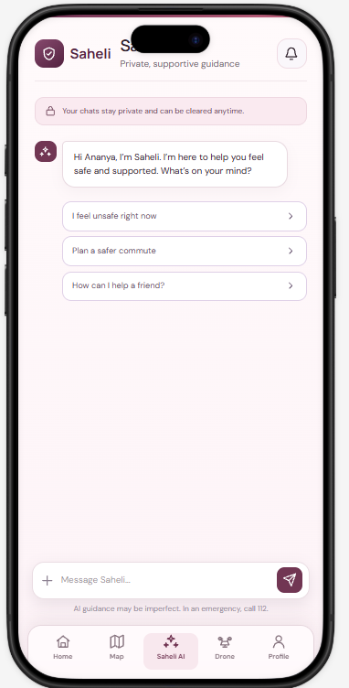
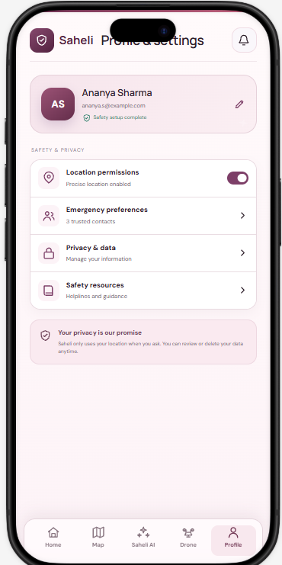
Someone to talk to, privately
SUPPORT AND TRUST
Saheli AI
Calm guidance for moments like feeling unsafe, planning a commute or helping a friend. Chats stay private and can be cleared.

Slide 7
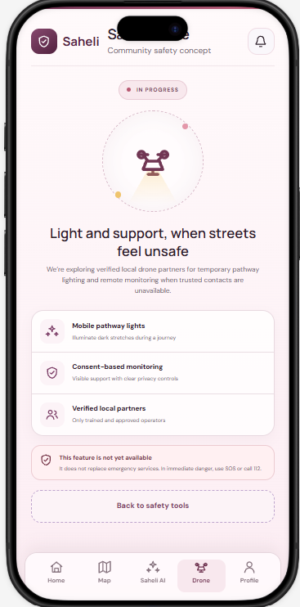
Light and support using drones, when streets feel unsafe
IN PROGRESS
Our community safety concept: verified local drone partners for temporary pathway lighting and remote monitoring when trusted contacts are unavailable.
Pathway lights
Monitoring
Illuminate dark stretches on a journey.
To look after you when you trusted contacts are far away

